Slide 1


Slide 2


Slide 3
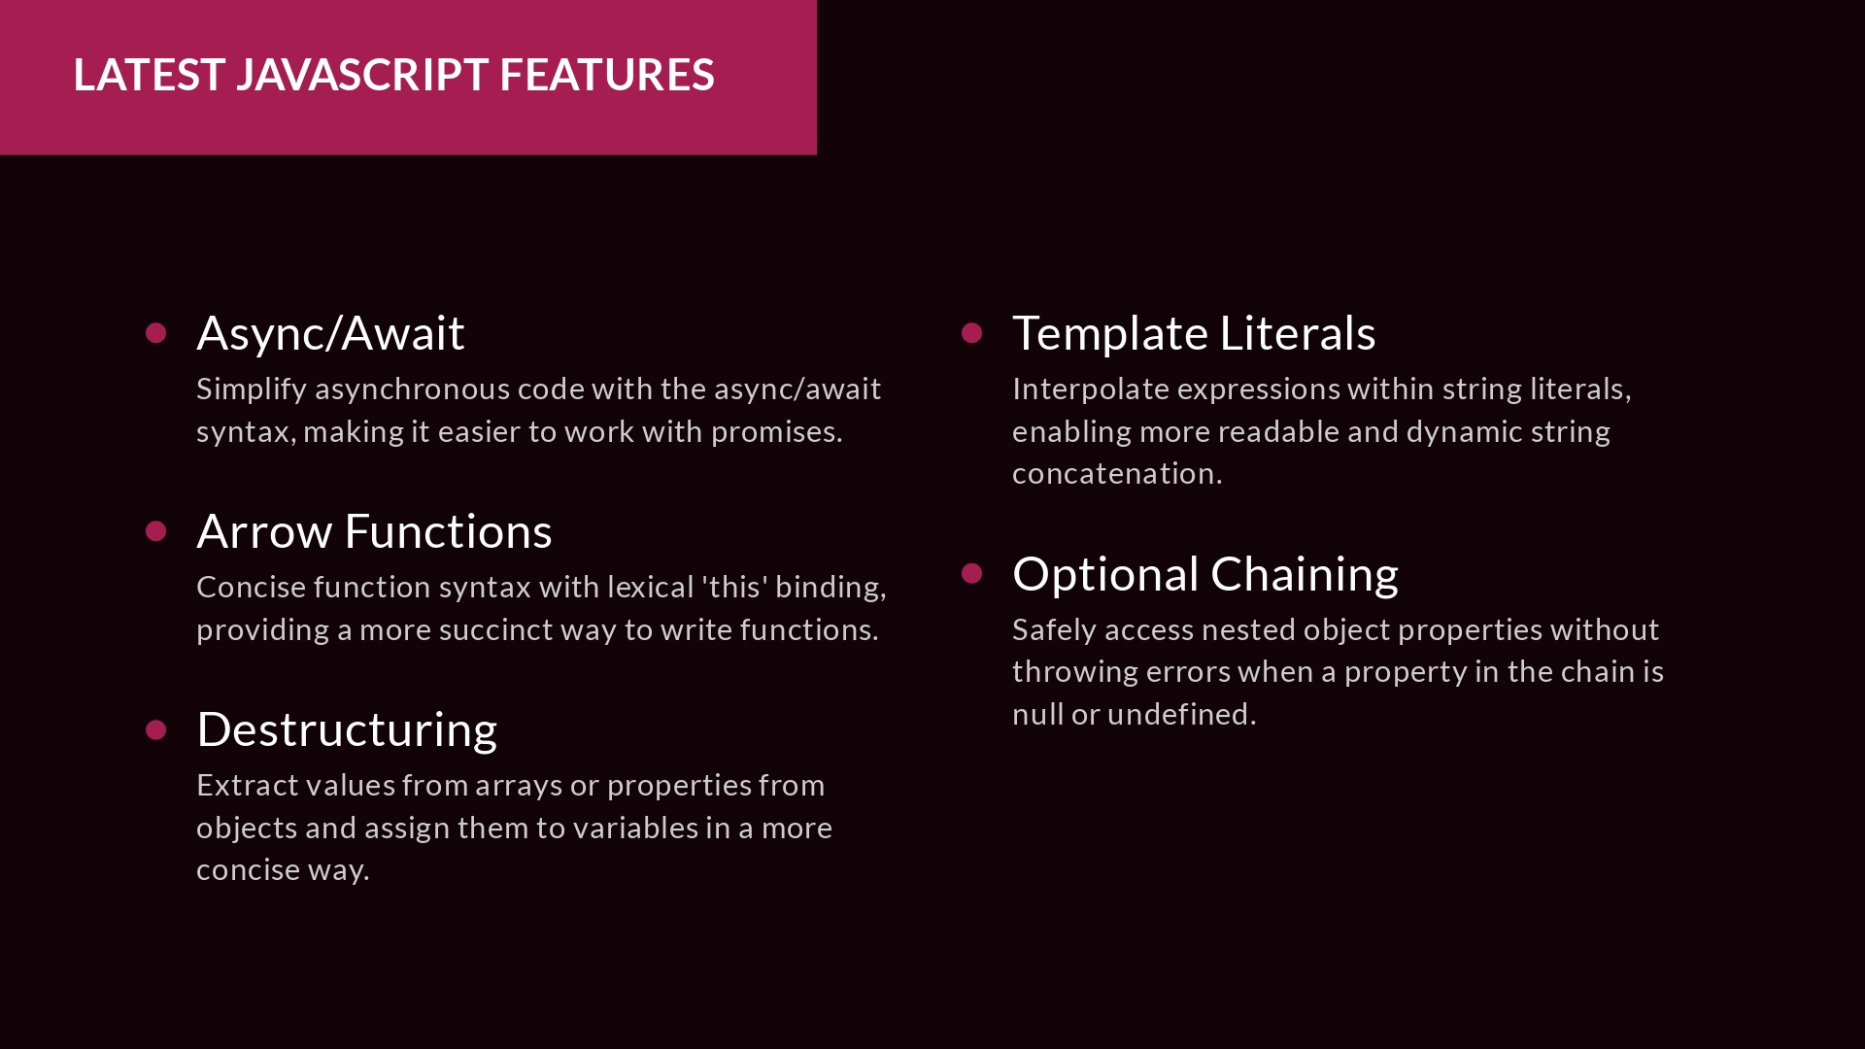
Notes:
Async/Await: is a native feature in Node.js that simplifies the process of managing tasks that take time, such as waiting for a response from an API. It makes it easier to write asynchronous code that is more readable, sequential, and better at error handling.
Arrow functions: in Node.js are a concise way to write JavaScript functions. They are introduced in the ES6 version and make the code more structured and readable.
Arrow functions are anonymous, meaning they don’t have a name, but they are often assigned to a variable or used as a function expression.
Arrow functions have a lexical this binding, which means they inherit the value of this from the enclosing scope. This feature can be advantageous when dealing with event listeners or callback functions where the value of this can be uncertain.
Arrow functions can reduce the size of the code, making it more readable and maintainable.

Slide 4


Slide 5


Slide 6


Slide 7


Slide 8

Notes:
It’s a popular front-end framework used for developing single-page, mobile, or server-rendered applications with reusable UI components. React is maintained by Meta (formerly Facebook) and a community of individual developers and companies.
React’s primary goal is to simplify the process of building interactive user interfaces by providing a declarative programming paradigm. Instead of directly manipulating the DOM, developers design views for each state of an application, and React updates and renders components when data changes.
React components are JavaScript functions that take input data and return React elements, which are then rendered to the DOM. These components can be reused throughout an application, making it easier to manage complex UIs.

Slide 9
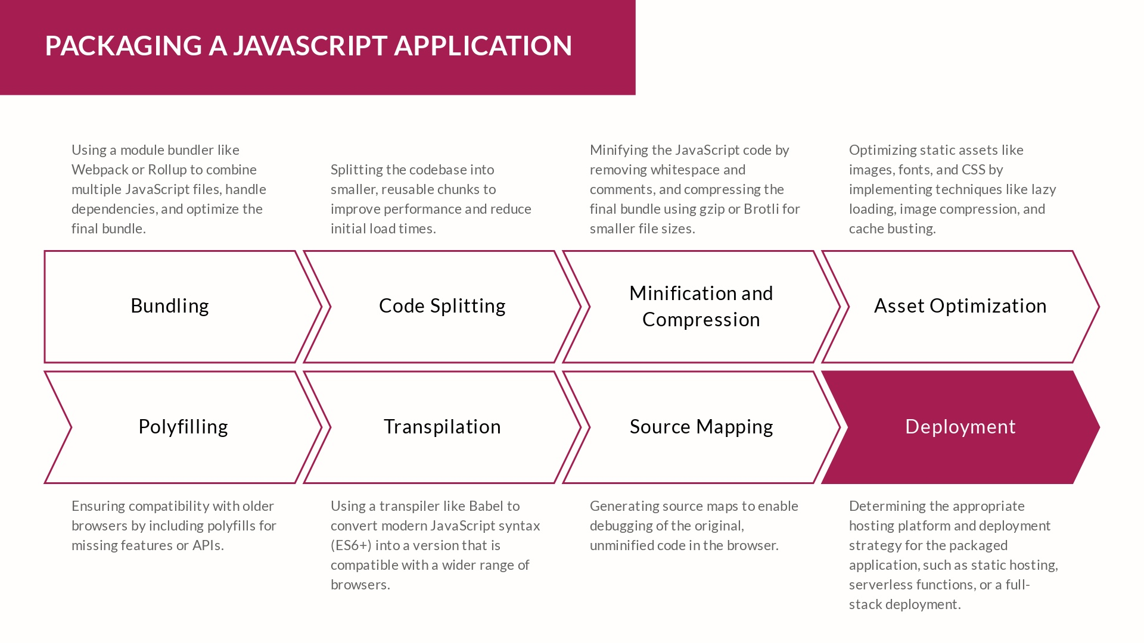

Slide 10

Notes:
DOM manipulation in vanilla JavaScript involves working directly with the Document Object Model (DOM) to add, remove, or modify elements, attributes, and content.
Getting Elements
document.getElementById: Returns an element by its ID.
document.querySelector: Returns the first element that matches a selector.
document.querySelectorAll: Returns a list of elements that match a selector.
Setting Attributes
element.setAttribute: Sets an attribute on an element.
element.getAttribute: Gets an attribute from an element.
element.removeAttribute: Removes an attribute from an element.
Setting Text Content
element.textContent: Sets the text content of an element.
element.innerText: Sets the inner text content of an element.
Adding Elements
document.createElement: Creates a new element.
document.appendChild: Adds an element to the end of a parent element.
element.insertAdjacentHTML: Inserts HTML content at a specified position.
Removing Elements
element.remove: Removes an element from the DOM.
element.parentNode.removeChild: Removes an element from its parent.

Slide 11
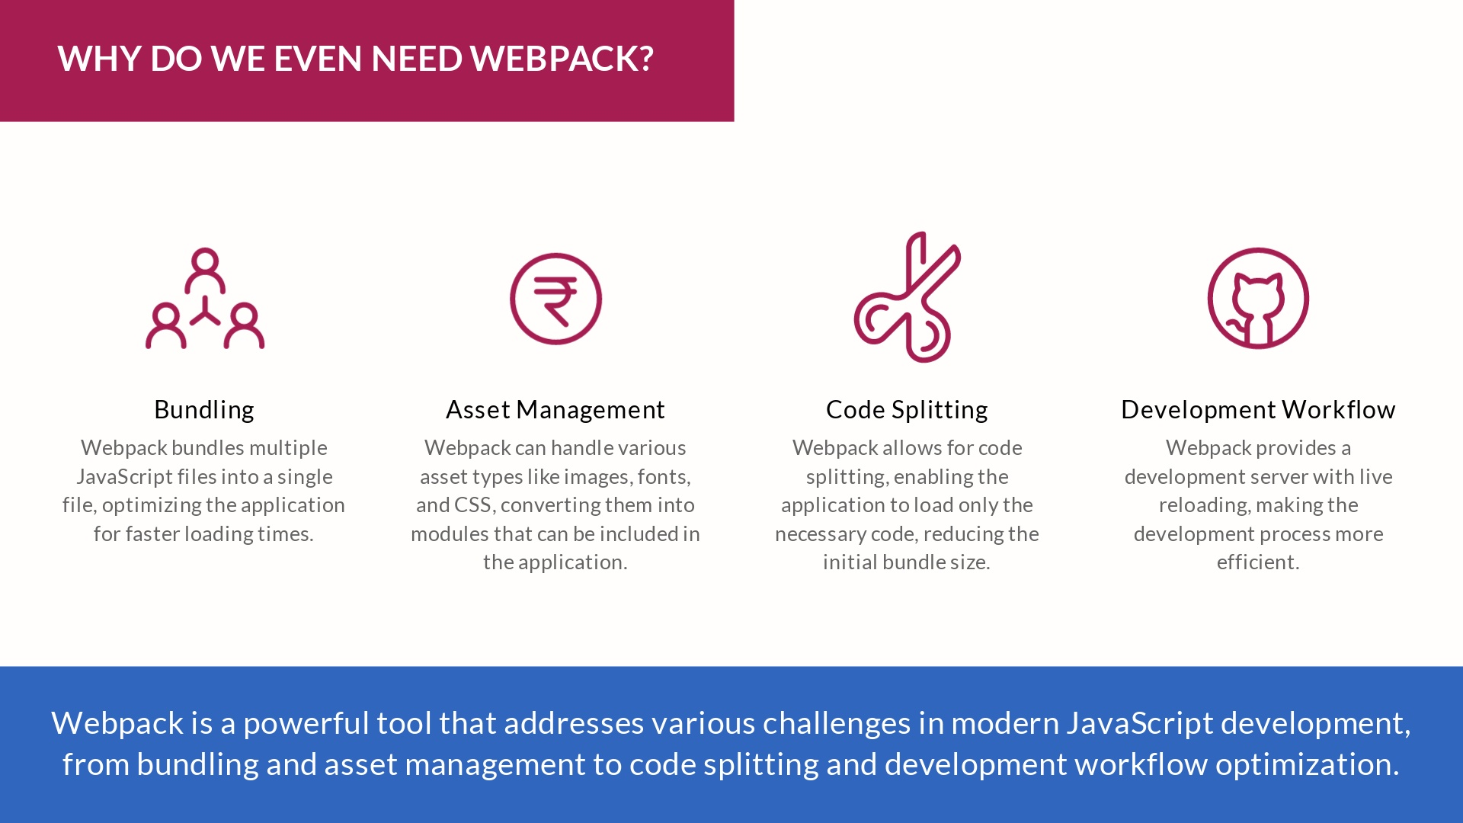

Slide 12


Slide 13


Slide 14


Slide 15


Slide 16


